Slide 1
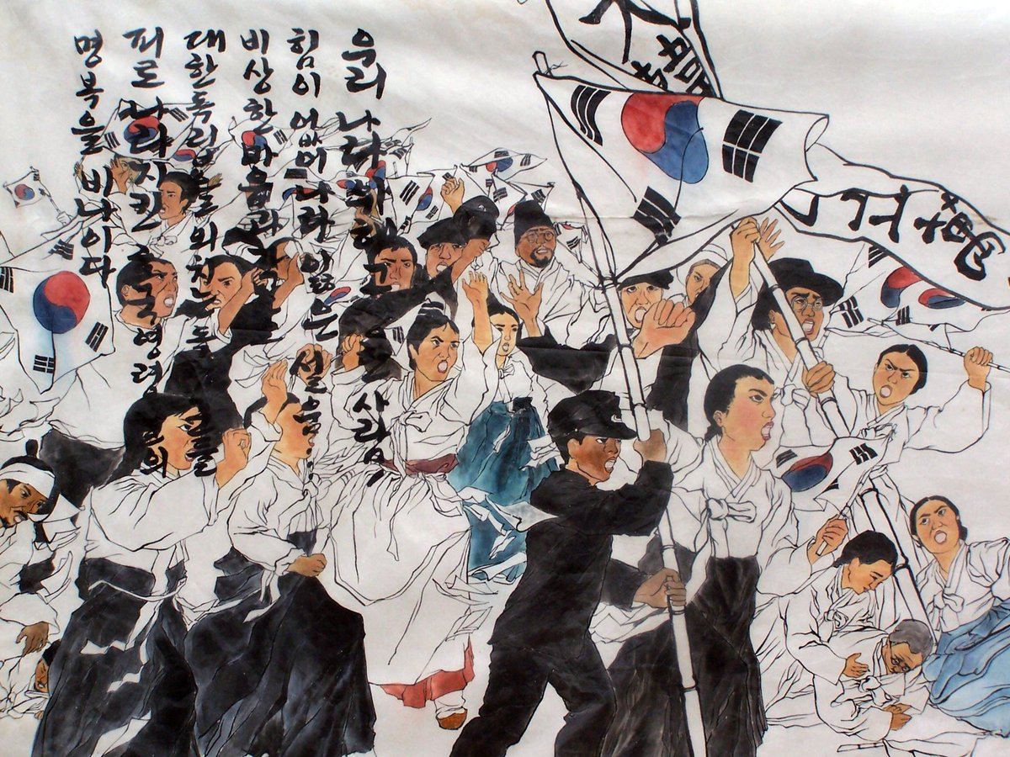

3·1운동
독립운동가들과 3·1 운동의 정신
Notes:
3·1운동, The March 1st Movement
Independence activists and the spirit of the March 1st Movement

Slide 2
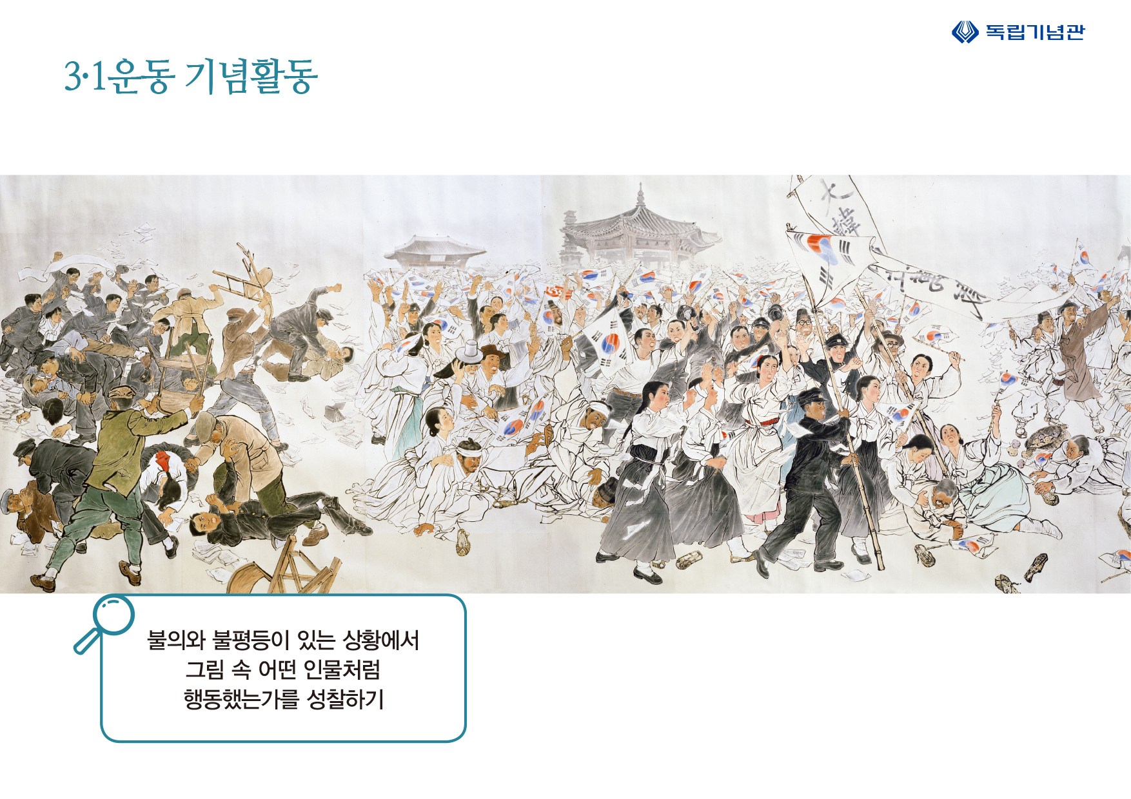
그림보고 이야기 나누기
Notes:
Look at this picture. It is a picture of March 1st, 1919, where people are shouting ‘대한독립만세’ ‘Long Live Korea’s Independence.’
What do you see in this picture?

Slide 3
3·1운동의 개요
대한민국의 뿌리
  일본 제국의 한반도 강점에 대한 저항
  시민들의 자발적 참여
  한민족 최대 규모의 독립운동
대한민국의 정통성
  대한민국 임시정부 수립의 계기
  대한민국 연호는 1919년을 원년으로 삼고 있음
Notes:
The 3·1 운동 was a major event that became a root of Korean spirit. It was a resistance movement against Japanese aggression, and people voluntarily participated. It was the largest independence movement of Korea.
And, the March 1st Movement was the starting point of establishing the provisional government of the Republic of Korea, 대한민국 임시정부. The title of “대한민국” has been used since 1919.

Slide 4
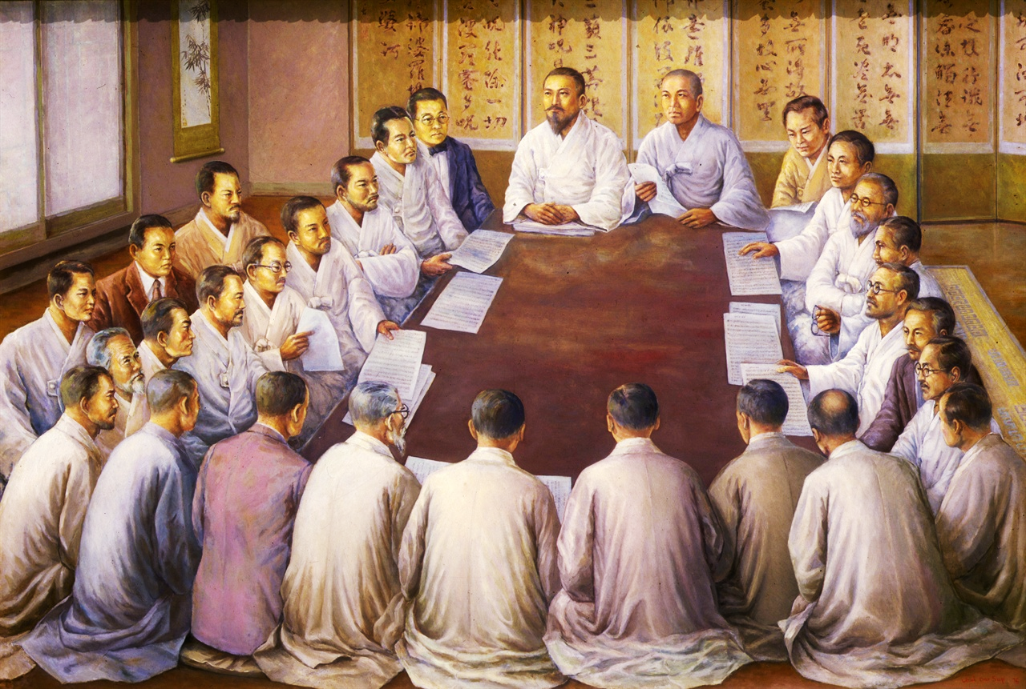
독립운동가들
민족 대표자 33인
각 종교계 대표자들
독립선언서에 서명을 하고 낭독함
Notes:
Now let’s look at the independence activists.
The photo shows 33 national representatives. The 33 people representing each religious group, signed and read the Proclamation of Korean Independence, 독립 선언서.

Slide 5
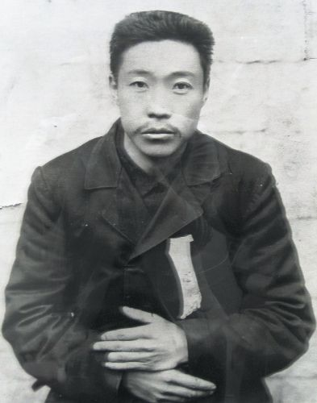
안중근 의사
(1879-1910)
항일 의병장 겸 정치 사상사
일본의 초대 한국통감
이토 히로부미를
만주 하얼빈 역에서 암살하였음
만주의 여순(뤼순) 감옥에서 순국
Notes:
This is 안중근. He was the leader of the Righteous Army and voiced his political opinions. He assassinated Ito Hirobumi, who was the first Japanese Resident-General of Korea. After the assassination in Harbin, Manchuria, 안중근 died in the Lushun Prison in Manchuria.

Slide 6
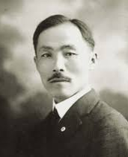
안창호 지사
(1878-1938)
일제강점기 독립운동가, 교육자, 정치가
미국 이민
샌프란시스코에서
흥사단 (Young Korean Academy)
창설
대한민국 임시정부 국무총리 역임
Notes:
This is 안창호. He was an independence activist, an educator and a politician. After immigrating to the United States, he founded the Young Korean Academy, 흥사단 in San Francisco. After that, He went to China and continued the independence movement, where he served as Prime Minister for the Provisional Government of the Republic of Korea, 대한민국 임시정부.

Slide 7
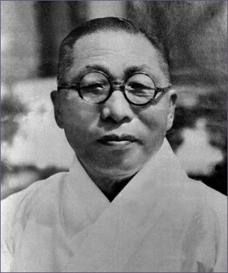
백범 김구
(1876-1949)
일제강점기 독립운동가
대한민국의 종교인, 교육자, 통일운동가, 정치인
대한민국 임시정부 주석 역임
Notes:
This is 백범 김구. He was an independence activist, a religious leader, an educator, and a politician. He served as the President for the Provisional Government of the Republic of Korea, 대한민국 임시정부.
There is a famous saying from 김구, saying 'I want to become the gatekeeper of the unified motherland and sweep the garden and clean the window.' ‘What I want the most is cultural power, not force,’ ‘I don't want my country to invade other countries because I know the pain of my country being colonized.'

Slide 8
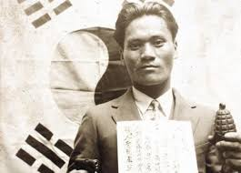
윤봉길 의사
(1908-1932)
일제강점기 독립운동가
1932년 상해 홍커우 공원에서 열린 일본 천장절 및 전승 기념식에서 폭탄을 투척하는 의거를 성공시킴
Notes:
This is 윤봉길. He was an independence activist and on April 1932 he succeeded in throwing bombs at the Japanese Festival and Victory Ceremony held in Hongkou Park under the direction of 백범 김구. He is known for the note he left to his two young sons. The letter said, ‘To the two soldiers wrapped in baby’s blankets, become brave fighters for 조선 and strive for independence. Don't be sad that I have died and left you without a father. Take good care of your mother and become great people.'

Slide 9
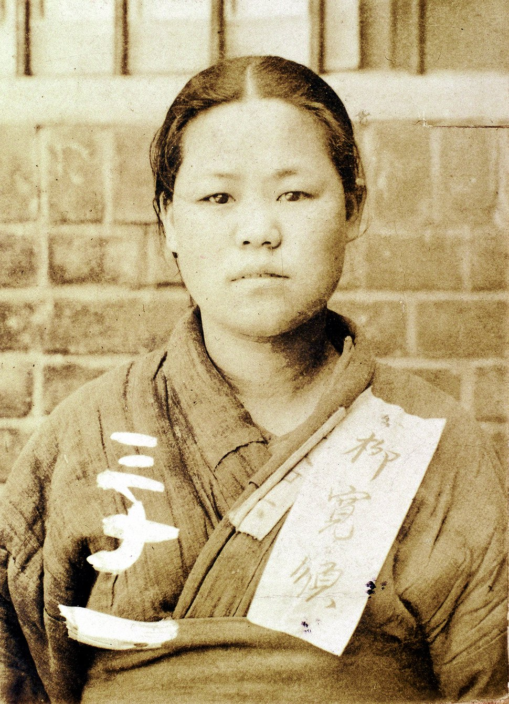
유관순 열사
(1902-1920)
일제강점기 독립운동가
이화학당 학생
3·1운동으로 휴교령이 떨어지자 고향 천안으로 내려와 만세운동을 주도함
Notes:
This is 유관순. She was a student at 이화학당 in Seoul. When the school was closed due to the March 1st Movement, she went down to her hometown 천안 and led an independence movement.

Slide 10
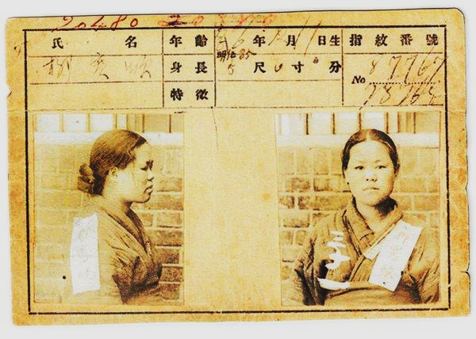
서대문 형무소에 수감된 뒤에도 대한독립만세를 외침
1920년 9월 28일 모진 고문을 이기지 못하고 감옥에서 순국함 (dying for one’s country)
서대문 형무소 수감증
Notes:
This photo was taken while 유관순 was imprisoned in 서대문 Prison. Even in the prison, she shouted for the independence of Korea. On September 28, 1920, she was unable to overcome the harsh torture and died in prison.

Slide 11
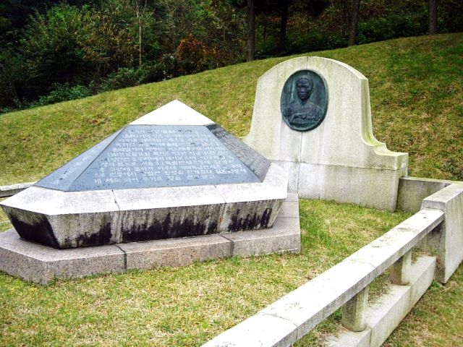
훼손된 시신으로 공동묘지에 묻혔다가 이장할 예정이었으나 일본의 방해로 유골 분실
유관순 열사 기념사업회에서 1989년 시신이 없는 채로 초혼묘 조성
유관순 열사 초혼묘
Notes:
The body of 유관순 was in an extremely damaged state due to torture and was buried in a cemetery. It was supposed to be relocated later, but the remains were lost due to Japanese interference. In 1989, a grave-site was built for her without her body.

Slide 12
“내 손톱이 빠져나가고 내 귀와 코가 잘리고 내 손과 다리가 부러져도 그 고통은 이길 수 있사오나 나라를 잃어버린 그 고통만은 견딜 수가 없습니다… 나라를 위해 바칠 목숨이 오직 하나밖에 없다는 것이 이 소녀의 유일한 슬픔입니다.” - 유관순 -
“Even if my fingernails are torn out, my nose and ears are ripped apart, and my legs and arms are crushed, this physical pain does not compare to the pain of losing my nation. […] My only remorse is not being able to do more than dedicating my life to my country.” – Yu Gwansun –
Notes:
유관순’s last known words were, “Even if my fingernails are torn out, my nose and ears are ripped apart, and my legs and arms are crushed, this physical pain does not compare to the pain of losing my nation. My only remorse is not being able to do more than dedicating my life to my country.”

Slide 13
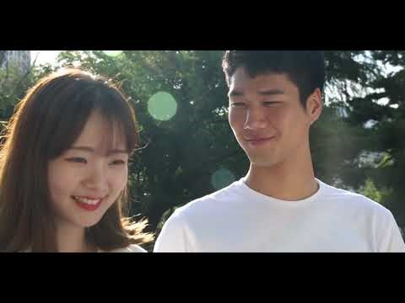
3·1 절 100주년 기념 영상 ‘감사합니다’
Notes:
This is a video to thank everyone who participated in the March 1st Movement.

Slide 14
내가 생각하는 3·1 운동은?
Notes:
What do you think of the March 1st Movement?

Slide 15
자료 출처
3·1 운동 자유와 독립을 향한 외침, 독립기념관 (2018)
3.1 운동 및 임시정부수립 100주년 기념작 '감사합니다‘: https://www.youtube.com/watch?v=MNLA7FUy5Q4
천안시 유관순 열사 기념관: https://www.cheonan.go.kr/yugwansun.do

